Slide 1
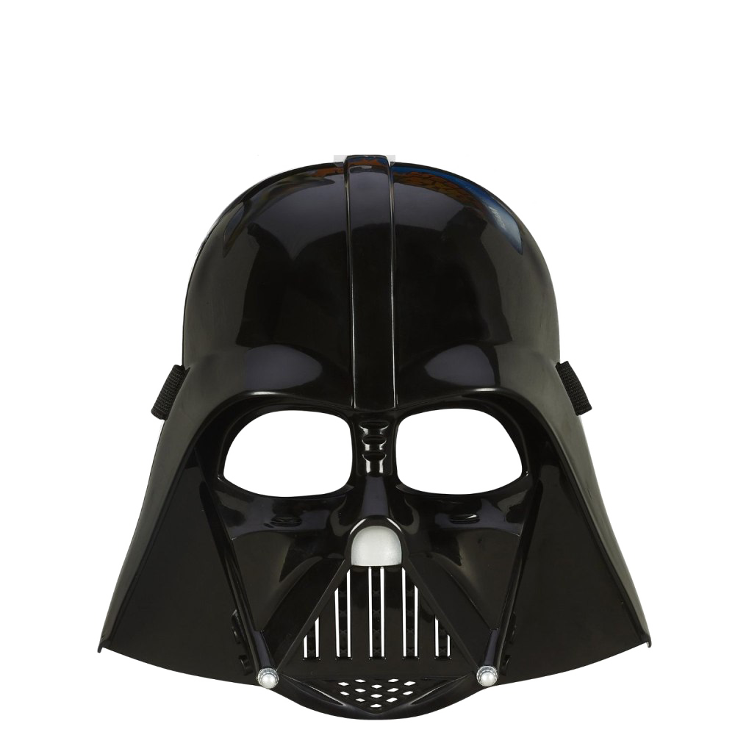






Quick Links
Replicating Microsoft’s web parts
Dan Toft
Microsoft 365 Consultant Denmark
Blog.Dan-Toft.dk
@Tanddant

Slide 2
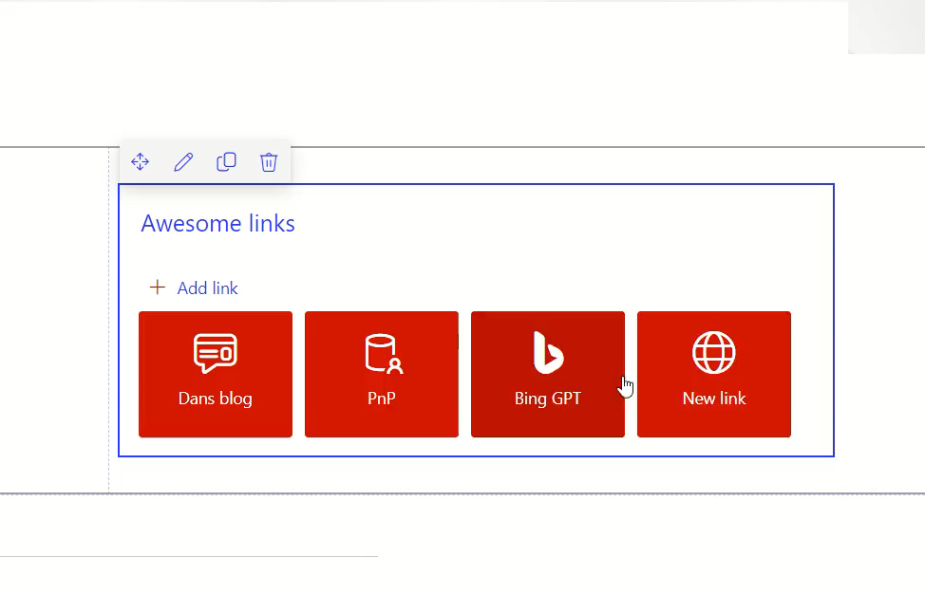
What is Quick links
Features:
Drag n’ drop
Dynamically changing property pane
Target links to current or new tab
Why?
Customize built in web parts
Demonstrate the usage of property pane
And practice using it!
The challenge(?)

Slide 3

Demo
Demo

Slide 4
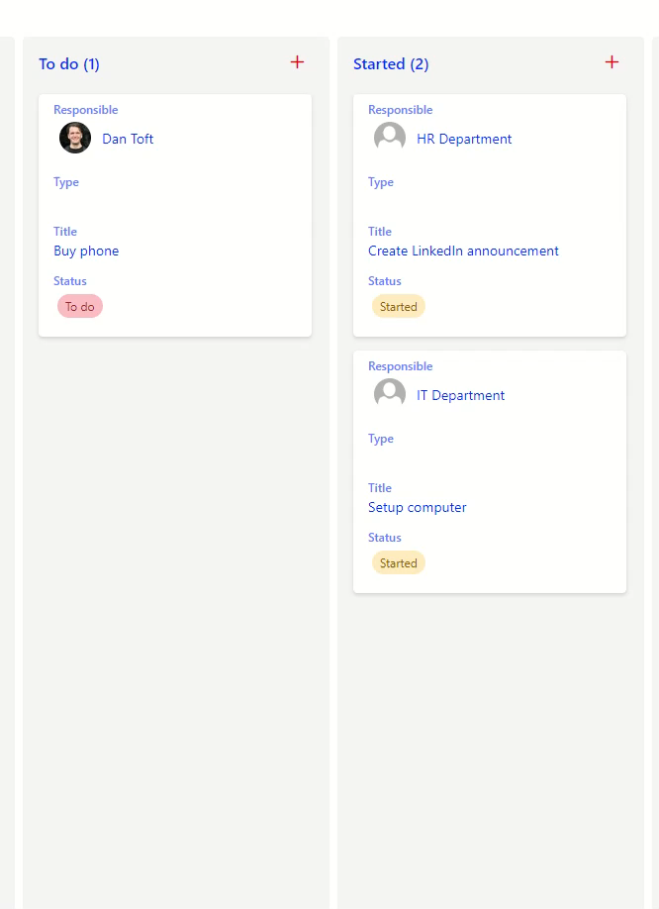
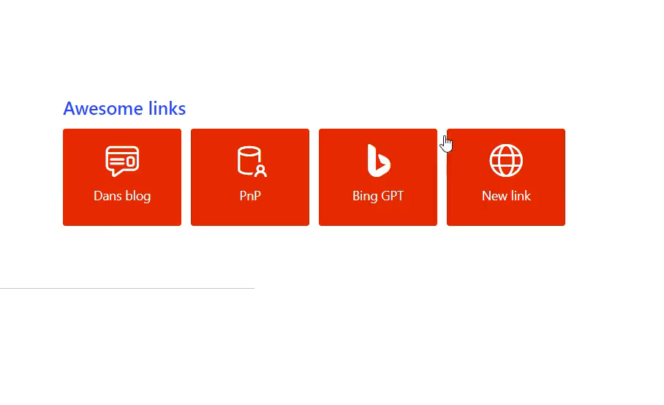
Sorting items!
… and storing it
Harder than you think (or at least I thought)

Slide 5

Calculating sort weight
({Before positions value} + {After positions value}) / 2
0 or 1 at the ends
Weight: 0.25
Weight: 0.125
Weight: 0.5
0
1
Weight: 0.375

Slide 6
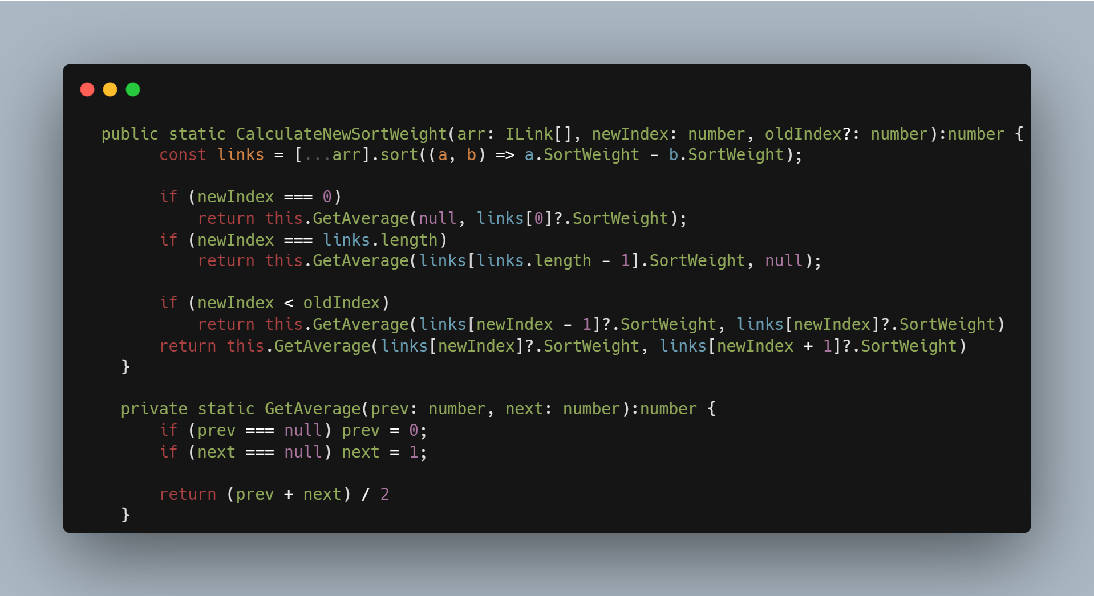

Slide 7
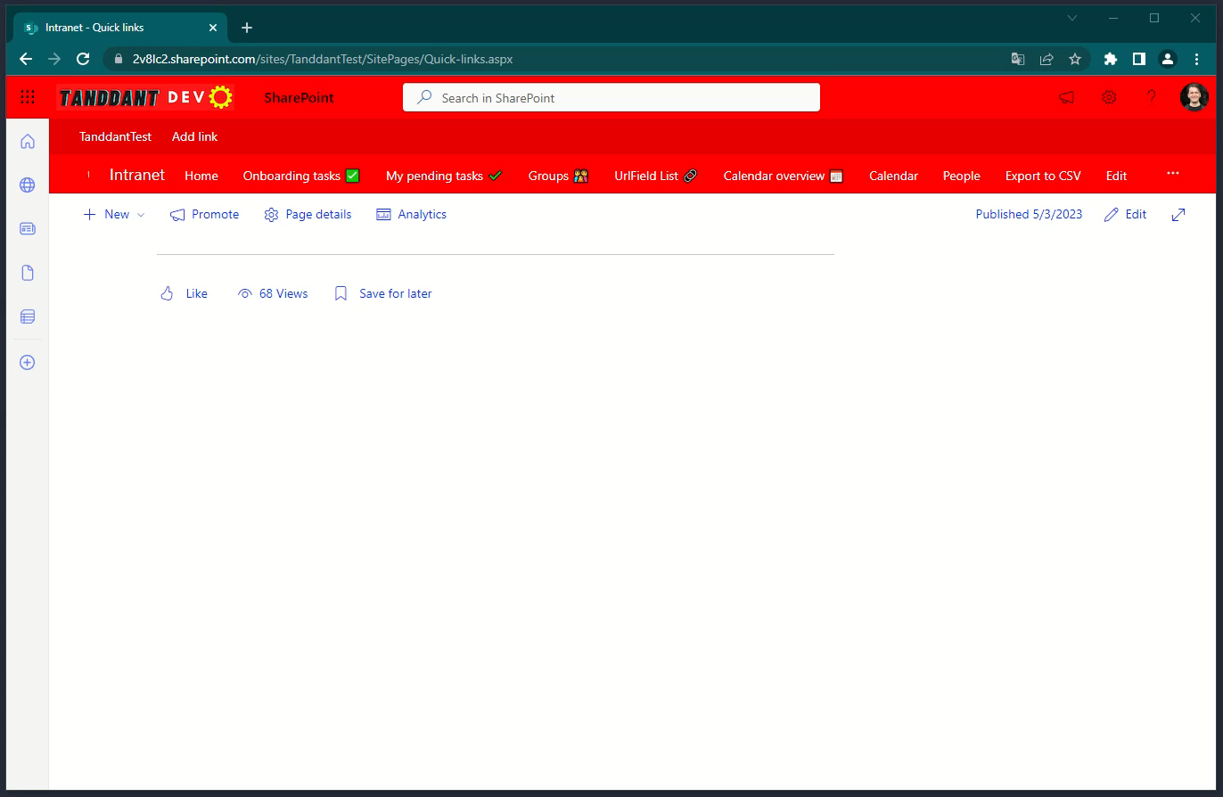
Property Pane

Slide 8
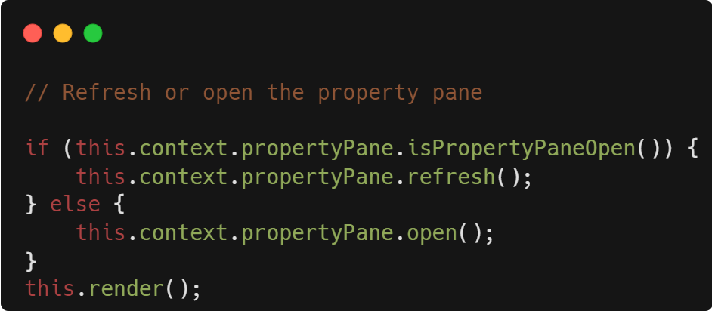
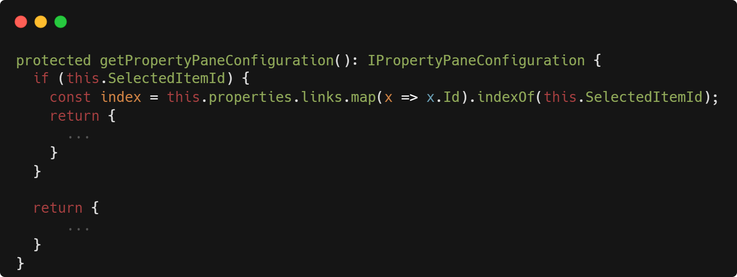
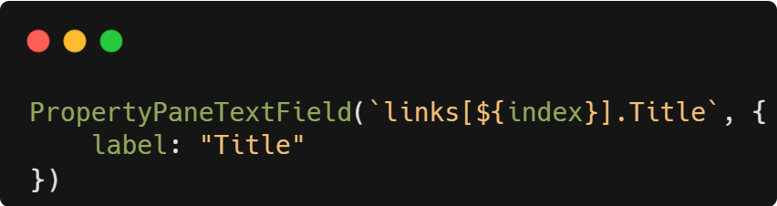
Property Pane tricks - Remember to use it!
You can access an array using index’s
You can open the property pane
The property pane isn’t static, stop thinking as such

Slide 9
Thank you!
Sample URL:
https://github.com/pnp/sp-dev-fx-webparts/tree/main/samples/react-quick-links
Dan Toft
Microsoft 365 Consultant Denmark
Blog.Dan-Toft.dk
@Tanddant

